Slide 1
Genome Assembly
Núria Hernando

Slide 2
CONTENTS
Key concepts of assembly
Genome assembly
Short VS long reads
Workflow
Future work
Bibliography

Slide 3
1. Key concepts of assembly

Slide 4
Let’s review some concepts
Contigs
Continuous reconstructed sequences.
Scaffolds
Two or more contigs separated by gaps.
Gaps
Unassembled or uncertain DNA regions.
Metrics
N50, size, coverage… They enable objective comparison of assembly quality across tools, datasets, or species.
Masking
Converting DNA (o RNA) fragments in a way that’s appropriate for downstream analyses.
Genome drafts
Scaffolds+ unresolved regions

Slide 5
2. What is genome assembly?

Slide 6
GENOME ASSEMBLY
Computational process which aims to reconstruct entire original genomic sequences of an organism from millions of short, sequenced DNA fragments/reads produced by sequencing machines.
Rectify errors generated during sequencing.
Resolve repetitives sequences.
Handle terabytes of sequencing data.
Illumina, PacBio,
Oxford Nanopore
De novo assembly
Reference-guided assembly
Build genome from scratch, without reference.
Reads aligned to a known similar genome.
Computationally repeatable and reproducible.
Findable, accessible, interoperable and reusable.

Slide 7
3. Short VS long reads

Slide 8
Short VS long reads
Feature | Short-Reads (Illumina, <300 bp) | Long-Reads (PacBio, Oxford Nanopore; 5–50 kb+)
Typical read length | 50–300 bp | 5,000–100,000+ bp
Error rate | Very low (0.1–1%) | Higher (5–15%, but improving)
Cost | Cheap per base | More expensive per base
Handling repeats | Hard | Easy (span repeats)
Diploid separation | Hard to resolve haplotypes | Better haplotype phasing
Assembly continuity | Fragmented | More complete, fewer gaps
Best for | Population studies, resequencing | De novo assembly, structural variants
Output | Many contigs | Longer contigs/full chromosomes

Slide 9
In conclusion:
Short reads →
Long reads →
Cheaper and accurate
Struggle with repeated nodes
Assemble complete genomes
Need polishing due to errors
The best is to combine both.

Slide 10
4. Workflow

Slide 11
Timeline
EXTRACTION
SEQUENCING
PREPROCESSING
ASSEMBLING
POST PROCESSING
FASTQC
Trimming
Scaffolding
Polishing
Evaluation

Slide 12
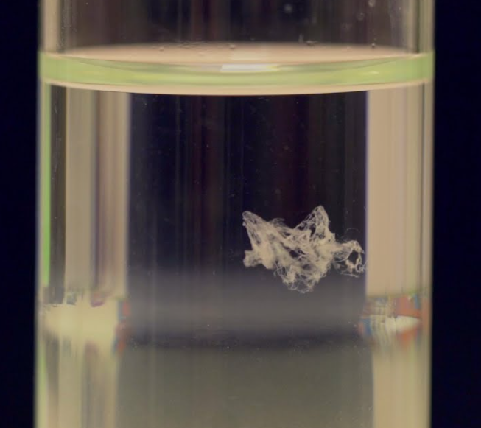
1,2. EXTRACTION AND SEQUENCING
Wet lab → raw data QC
Obtaining DNA from an organism.
!!! Right tissue and minimization contamination.
Third-generation sequencing

Slide 13
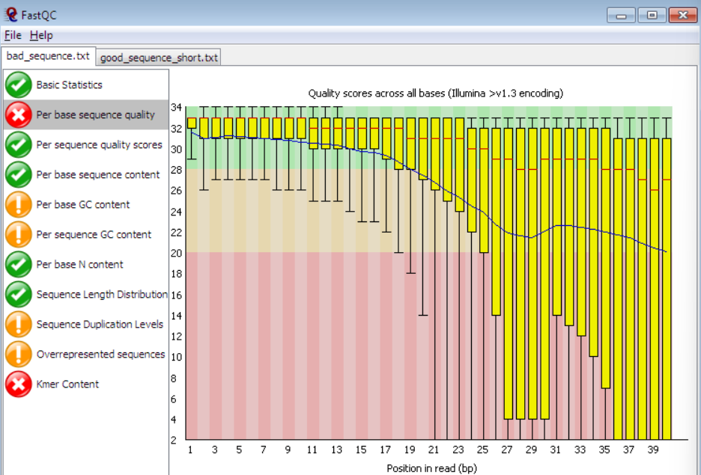
3. PREPROCESSING
Quality control → FastQC
QC tool for high throughput sequence data.
It imports data from SAM, BAM or FastQ files. The results are in HTML.
Other tools: metrics (N50, coverage, N90, number of genes, number of gaps…)

Slide 14
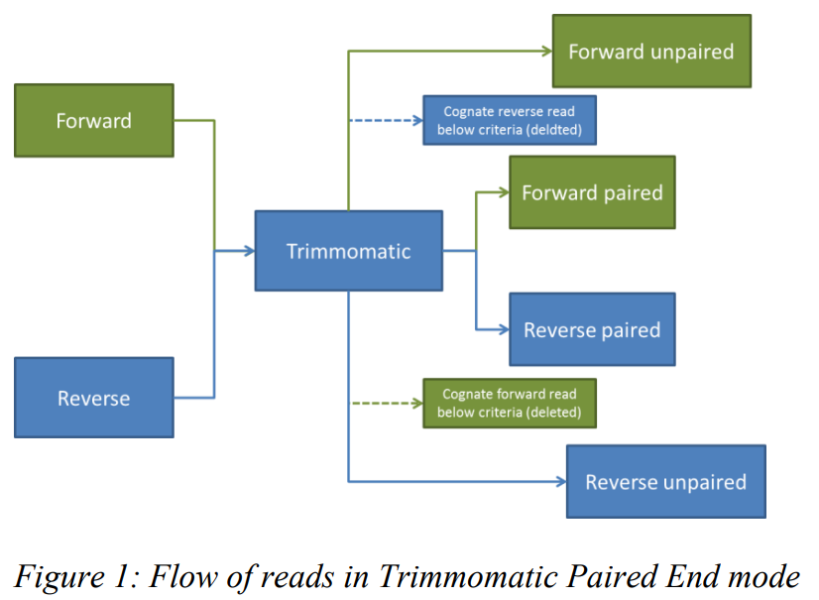
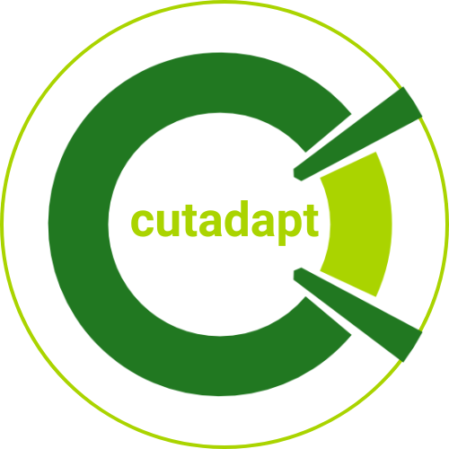
3. PREPROCESSING
BUSCO [Benchmarking Universal Single-Copy Orthologs] (conserved genes).
Quantifications of completeness. It is used OrthoDB database.
Trimming:
Raw files to fill mising bases and correct sequencing.
Trimmomatic, Cutadapt, Racon/Pilon

Slide 15
4. ASSEMBLING
SPAdes | Prokaryotic
MaSuRCA | Short and long reads (eukaryotic)
Canu | Long reads
Falcon | Long reads
Platanus | Highly heterozygous

Slide 16
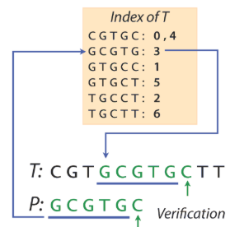
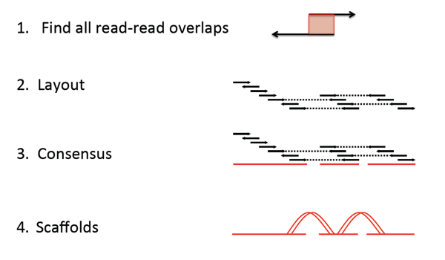
4. ASSEMBLING
De Brujin Graph (DBG)
Overlap string graph (OCL)

Slide 17
4. ASSEMBLING
De Brujin Graph (DBG)
Overlap string graph (OCL)
Euler-USR
Velvet (short read to eliminate errors and resolve repeats).
ABySS(identify polymorphic regions, assembles large data sets and identifies indels and novel sequences).
AllPath-LG
SOAPdenovo
Aeachne
Celera Assembler (handles data from different platforms)
CAP3 (large genomes)
PCAP
Pharp
Phusion
Newbler (de novo assembly from Roche 454)

Slide 18
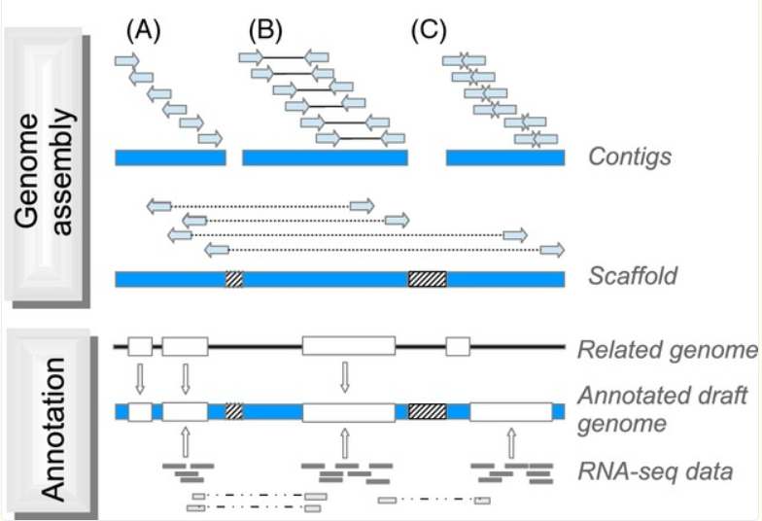
5. POST PROCESSING
Scaffolding
Fills the unknown sequences between gaps.
Gap filling
Replacing N’s with sequence, often using long reads.
Both can be performed with low coverage.
SALSA, HiRise, 3D-DNA, ALLMAPS, Supernova, ARCS.
Polishing
Correct errors with extra readings.
Helps to improve local base accuracy.
Pilon, Rakon, Medaka.

Slide 19
6. ANNOTATION
Repeat Masking
(Repeat Modeler and RepeatMasker)
Evidence integration
(MAKER or PASA)
Publication
(NCBI BioProject, GenBank, ENA)
1
3
5
2
4
Gene prediction
Ab initio (AUGUSTUS)
External evidence
QC & manual curation
(WebApollo)

Slide 20

6. ANNOTATION
Genome assembly must be repeatable and reproducible. To ensure this, we use:
Containers like Docker or Singularity, which guarantee identical software environments.
Workflow managers like Nextflow or Snakemake for automated, traceable pipelines.
FAIR principles: making data and software Findable, Accessible, Interoperable, and Reusable.
Functional annotation → assign biologically relevant information to predicted polypeptides
GO terms, names, pathways, tools like InterProScan or eggNOG-mapper, MAKER, BRAKER

Slide 21
5. Future work

Slide 22
FUTURE
STRENGTHS
WEAKNESSES
- Some assemblies remain fragmented.
- Dependence on coverage, sequencing quality and parameters.
- Difficult regions remain unsolved.
- Enables reconstruction of most coding regions.
- Can handle large volumes or NGS data.
S
W
IMPROVEMENTS
IMPROVEMENTS
- Integrate long-read sequencing to resolve repeats.
- Alternative assemblers and post-assembly tools
I
- Optimizing parameters.
- Incorporate more rigorous QC and polishing steps.

Slide 23
BIBLIOGRAPHY
Severin A. Introduction to Genome Assembly [Internet]. Bioinformatics Workbook. Available a partir de:https://bioinformaticsworkbook.org/dataAnalysis/GenomeAssembly/Intro_GenomeAssembly.html#gsc.tab=0
Babraham Bioinformatics - FastQC A Quality Control tool for High Throughput Sequence Data [Internet]. Available a partir de: https://www.bioinformatics.babraham.ac.uk/projects/fastqc/
Ekblom, R., & Wolf, J. B. (2014). A field guide to whole-genome sequencing, assembly and annotation. Evolutionary applications, 7(9), 1026–1042. https://doi.org/10.1111/eva.12178
Del Angel VD, Hjerde E, Sterck L, Capella-Gutierrez S, Notredame C, Pettersson OV, Amselem J, Bouri L, Bocs S, Klopp C, Gibrat JF, Vlasova A, Leskosek BL, Soler L, Binzer-Panchal M, Lantz H. Ten steps to get started in Genome Assembly and Annotation. F1000Research [Internet]. 2018 feb 5;7:148. Available a partir de: https://pmc.ncbi.nlm.nih.gov/articles/PMC5850084/
Genome Assembly in Bioinformatics: Definition, Methods and Case [Internet]. CD Genomics. Available a partir de: https://www.cd-genomics.com/resource-genome-assembly-bioinformatics-definition-methods-case.html
Ekblom R, Wolf JBW. A field guide to whole‐genome sequencing, assembly and annotation. Evolutionary Applications [Internet]. 2014 jun 24;7(9):1026-1042. Available a partir de: https://pmc.ncbi.nlm.nih.gov/articles/PMC4231593/
Amatore Z, Gunn S, Harris LK. An Educational Bioinformatics Project to Improve Genome Annotation. Frontiers In Microbiology [Internet]. 2020 dic 7;11:577497. Available a partir de: https://doi.org/10.3389/fmicb.2020.577497
Genome Assembly [Internet]. BIOTECHNOLOGY CENTER. Available a partir de: https://biotech.wisc.edu/brc/services/genome-assembly/
Kibet CK, Entfellner JBD, Jjingo D, De Villiers EP, De Villiers S, Wambui K, Kinyanjui S, Masiga D. Designing and delivering bioinformatics project-based learning in East Africa. BMC Bioinformatics [Internet]. 2024 abr 14;25(1):150. Available a partir de: https://pmc.ncbi.nlm.nih.gov/articles/PMC11017571/
Mardis ER. The impact of next-generation sequencing technology on genetics. Trends In Genetics [Internet]. 2008 feb 13;24(3):133-141. Available a partir de: https://pmc.ncbi.nlm.nih.gov/articles/PMC2680276/
Peona V, Blom MPK, Xu L, Burri R, Sullivan S, Bunikis I, Liachko I, Haryoko T, Jønsson KA, Zhou Q, Irestedt M, Suh A. Identifying the causes and consequences of assembly gaps using a multiplatform genome assembly of a bird‐of‐paradise. Molecular Ecology Resources [Internet]. 2020 sep 16;21(1):263-286. Available a partir de: https://doi.org/10.1111/1755-0998.13252
Xiao W, Wu L, Yavas G, Simonyan V, Ning B, Hong H. Challenges, Solutions, and Quality Metrics of Personal Genome Assembly in Advancing Precision Medicine. Pharmaceutics [Internet]. 2016 abr 22;8(2):15. Available a partir de: https://pmc.ncbi.nlm.nih.gov/articles/PMC4932478/
Genome Assembly: Overview of the Tools [Internet]. CD Genomics. Available a partir de: https://www.cd-genomics.com/resource-genome-assembly-overview-tools.html
PacBio. Beyond contiguity — assessing the quality of genome assemblies with the 3 Cs [Internet]. PacBio. 2022. Available a partir de: https://www.pacb.com/blog/beyond-contiguity/
https://www.sciencedirect.com/topics/agricultural-and-biological-sciences/genome-assembly,https://academic.oup.com/bioinformatics/article/31/19/3210/211866, https://www.reddit.com/r/bioinformatics/comments/rtayb/how_difficult_is_it_to_assemble_and_annotate_a/,https://academic.oup.com/bfg/article/18/1/1/5181442, ttps://www.sciencedirect.com/org/science/article/pii/S1875036218000031

Slide 24
thanks!
Any questions?
?

